Slide 1

National Conservation Planning Partnership
(NCPP)

Slide 2

What is NCPP?
The National Conservation Planning Partnership (NCPP) represents the efforts of five key national conservation partners to reinvigorate conservation planning.
Notes:
The National Conservation Planning Partnership represents a national effort and commitment by the five (5) National Conservation Partners (National Association of Conservation Districts, National Association of State Conservation Agencies, National Association of Resource Council and Development Councils, National Conservation Districts Employee Association and the Natural Resources Conservation Service) to reinvigorate conservation planning by strengthening the support for field conservationists to work with clients in developing and implementing conservation plans. As most folks know, The nine (9) step planning process includes identifying client business objectives, determining the clients objectives, identifying and assessing resource concerns, analyzing resource data, formulating alternatives, evaluating conservation problems and opportunities, providing information to allow the client to make a well informed decision utilizing science-based tools as well as information to implement the plan and evaluate the effectiveness of the plan in addressing the identified resource concerns.

Slide 3
NCPP Partners
  Natural Resources Conservation Service (NRCS)
  National Association of Conservation Districts (NACD)
  National Association of State Conservation Agencies (NASCA)
  National Conservation District Employees Association (NCDEA)
  National Association of Resource Conservation and Development Councils (NARC&DC)
Notes:
NCPP recognizes it is only through the leadership, support and commitment of the conservation partnership in the states that this effort will be successful. NCPP is committed to helping all leaders and employees . In addition, through ongoing dialogues, we will plan to identify the challenges and needs in question, for ensuring that the technical skills and applicable staff years (employees) are assigned and equipped to help get conservation on the ground.
Together, we will achieve this goal!

Slide 4
NCPP’s Purpose
To reinvigorate conservation planning by enhancing and strengthening the planning process and our partnership workforce.
Notes:
NCPP recognizes it is only through the leadership, support and commitment of the conservation partnership in the states that this effort will be successful. NCPP is committed to helping all leaders and employees . In addition, through ongoing dialogues, we will plan to identify the challenges and needs in question, for ensuring that the technical skills and applicable staff years (employees) are assigned and equipped to help get conservation on the ground.
Together, we will achieve this goal!

Slide 5
NCPP Goals
  Reinvigorate conservation planning
  Improve the partnership’s capacity to deliver one-on-one conservation planning assistance as well as at all scales
  Ensure the delivery of voluntary, science-based assistance
  Build and sustain a workforce of strong conservation planners across the partnership
Notes:
There is no virtue in planning merely for the sake of planning. Unless plans can be translated into action, planning becomes a profitless mental exercise.
This effort is a call to action to ensure that conservation planning becomes the focal point that allows the utilization of the various tools of implementation for the client. Establishing these goals , will allow for the Partnership to ensure that we have provided the key assistance needed to help the farmer, rancher or other customers meet their goals.

Slide 6
What Does NCPP Mean For The Partnership?
Highly skilled and trained workforce
Development of new tools and technology
Ability to provide improved customer service
An enhanced, united workforce for conservation
The delivery of voluntary, science-based technical assistance
Notes:
Our Communication and Messaging Team is developing new marketing products and providing staff unique opportunities to share ideas and approaches to put conservation planning first.
Our Performance, Outcomes, Goals, and Accountability Team is reassessing how we measure performance, and developing ways to measure the value of planning practices.
Our Partnership and Leveraging Capacity Team is working to acquaint or reacquaint traditional and non-traditional partners with this information, and to leverage each partner’s strengths and expertise.
Our Training, Certification, Technical Processes and Tools Team is implementing strategies and policy that will enhance and provide greater availability of training and tools to build capacity and meet our customers’ needs.
One of the reasons this effort came about is the survey results from NCPP partner employees that identified employees needs .
The direction for these teams came about as a result of the NCPP surveys, which were administered to field staff, district supervisors and farmers/ranchers. Responses showed that in order for this effort to be successful it required increases in staffing, staff development, and a leadership shift to prioritize planning. Plans were put into place by these teams to develop action items to address the concerns of both state leaders and field employees in implementing NCPP goals.

Slide 7
2018 Listening Sessions
Eight Listening Sessions have been completed in the following states:
  Indiana
  Minnesota
  Texas
  Washington State
  New York
  Nebraska
  North Carolina
  Wyoming
The purpose of the listening sessions was to share in-depth details on the status of conservation planning and its future and to hear feedback from all.
Notes:
During 2018, NCPP held eight listening sessions in Indiana, Minnesota, Nebraska, New York, North Carolina, Texas, Washington and Wyoming to share detailed information about the status of conservation planning, learn from our employees and producers about the barriers to effective, on-the-ground conservation planning, and to discuss the future of conservation planning.

Slide 8
What Was Achieved
201 individual items of feedback, suggestions from 8 Listening Sessions
NRCS employees, partnership employees, state conservation partnership leaders, conservation district supervisors, volunteers, and agricultural producers participated
Over 1,035 participants (in-person and on-line)
Feedback was received verbally, written and electronically

Slide 9
Summary of Recommendations
Communications. Use clear and consistent messaging and guidance to improve internal communications.
Apply transparent, common-sense methodologies that are customer friendly. Develop and support business tools that can be tailored to the locally established customer priorities. This in addition to a simplified access point, will reduce duplication and increase engagement to allow for expansion of technology that will improve the conservation planning process and address natural resource concerns.
Streamlining of current program policy to increase workload efficiencies. Review and update policy to ensure ranking criteria is consistent with statutory requirements established for financial assistance programs. Improve the internal processes for programmatic decisions to increase program efficiency and quality assurance with the certainty our customers deserve and respect.

Slide 10
Summary of Recommendations
Training. Expand the training options for delivering national, regional and state based training that will provide more realistic levels of training needed for NCPP employees and other participants, to ensure that we are able to address the producers’ needs.
Field employees receive clear messaging of benefits of conservation planning implementation. Use Conservation Effects Assessment Project (CEAP) or other modeling methods to communicate and quantify benefits and outcomes to help customers (internal and external alike) better understand the effectiveness of conservation practices. This in addition to a simplified planning process will increase customer engagement and allow for the continuous adoption of a conservation plan.

Slide 11
ACCOMPLISHMENTS

Slide 12
Communications
Hugh Hammond Bennett (HHB) Awards
The National Conservation Planning Partnership (NCPP) established the Hugh Hammond Bennett (HHB) Award for Conservation Excellence in 2017. This award recognizes both producers and conservation planners from within the NCPP partnership who have exemplified outstanding service through development and implementation of sound conservation planning and other conservation techniques.
One national winner in each category—producer and conservation planner—is chosen each year and recognized at the National Association of Conservation Districts (NACD) annual meeting.
NCPP is requesting that every state conservation partnership participates by selecting a state HHB Award winner in each category—producer and conservation planner.
This may be as simple as nominating the winner of your existing state-level conservation district award such as “Cooperator of the Year,” “Farmer of the Year,” etc.
Also, some states have established “Conservation Planner of the Year” or “Conservationist of the Year” awards for recognizing their employees which may be compatible with the criteria for the planner award.
To submit a nomination please follow this link: 2021 Hugh Hammond Bennett Award for Conservation Excellence Nomination Form - Formstack . Note: You may save the nomination and come back to it at any time by hitting 'save and resume.’
All nominations must be completed and submitted by October 1st.
Link to NCPP website: HHB Award Eligibility | National Conservation Planning Partnership
If you have any questions or concerns, please contact coordinator@ncpp.info
Notes:
The HHB Award launched in 2017. A new conservation planner category was added shortly after.
NCPP is requesting that every state conservation partnership participates by selecting a state HHB Award winner in each category—producer and conservation planner.
To submit a nomination please go to the NCPP Website under awards and follow the appropriate link.
Nominations are due by October 1st
If you have any questions or concerns, please contact coordinator@ncpp.info

Slide 13
Communications
NCPP Website and GovDelivery Newsletters
NCPP launched our website in 2019.
  Visit National Conservation Planning Partnership to view conservation planning resources, learn more about NCPP efforts and sign up to receive direct updates.
Monthly Newsletters through GovDelivery
  Relevant Information and Timely Updates
  Technical Guidance and Information
  Employee Spotlights
  Action Team Accomplishments
  Upcoming Training Sessions and Webinars
      Suggestions and Feedback to improve the conservation planning process
        We’re always open to new ideas to improve conservation planning!
Notes:
The website launched in 2019 and houses all available conservation partnership planning resources, along with updates on policy, training needs and tools.
During phase one, we wanted to ensure that employees received messages in a timely manner which offered solutions to the issue's employees were experiencing. The communications committee developed and issued messages to provide project updates and share timely information. The committee is tasked with asking the hard-hitting questions to ensure that we have identified what would be helpful to our employees. GovDelivery was used during phase one and allowed for a one stop tool to communicate directly with all employees. This in addition, allowed for employees to opt-in for communications. We worked across the partnership to develop an extensive list for our employees.
NCDEA and the communication team is working with our Marketing group to expand the website that has been developed to share additional information with employees and partners.
Phase 2 will pull in new partners and groups that will help to leverage identified funding and resource needs.
We will be branding NCPP and all messages will be issued direct from NCPP versus GovDelivery.
Each month we distribute a newsletter to provide key updates, technical information and guidance to the conservation partner employees.
To date, there have been 10 newsletters issued that will focus and feature ongoing works and efforts within conservation.
This in addition to featuring our dynamic conservationist allows us to highlight what works in the field and across the conservation partnership.
We’re always open to new ideas to improve conservation planning!

Slide 14
CONSERVATION PLANNING POLICY REVISIONS
The NRCS Conservation Planning Policy (General Manual 180, Part 409) was revised again in 2019. This minor revision incorporated language to allow for automated resource assessment and updated a couple of courses for conservation planner designation. Changes include:
Modified paragraph 409.1 E
A conservation plan is a record of the client’s decisions and supporting information for treatment of a unit of land for one or more identified natural resource concerns as a result of the planning process. The plan describes the schedule of implementation for practices and activities needed to address identified natural resource concerns and takes advantage of opportunities. The needs of the client, the resources, and Federal, State, Tribal, and local requirements will be met.
Added paragraph 409.1 G
A nationally supported tool that automates and streamlines the resource concern assessment process (e.g. Conservation Assessment Ranking Tool or Conservation Desktop) can be used to document meeting FOTG planning criteria for conservation program planning purposes. Although an automated assessment tool may not directly rely on the assessment methodology identified in the planning criteria, it utilizes similar inputs to provide thresholds to document whether planning criteria have been achieved.
409.9 D (3) i and ii - Due to new AgLearn courses being developed, added AgLearn to the options for taking the following training and removed on the job training as an option.
  Using Basic Soil Survey Information in Conservation Planning.
  Fundamentals of highly erodible land (HEL) and wetland conservation (WC) provisions training

Slide 15
National Planning Procedures Handbook (NPPH) Revision
The NPPH is the handbook used by conservation planners that describes the NRCS conservation planning process and procedures.
NPPH Amendment 7 was posted in January 2020 and included many major changes, such as changes to land use designations and modifiers, conservation plan requirements, definitions, and several figures and exhibits were removed if outdated or didn’t significantly clarify handbook content.

Slide 16
Tools
Implemented Document Management System, to streamline financial assistance contracts.
Developed National Conservation Planner Database containing 6,400 planners, including 1,200 partners.
Completed roll-out and expansion of the Conservation Client Gateway.
Updated Customer Service Toolkit to increase user productivity.
Completed testing of Conservation Desktop with over 100 tester including partners.
Appointed POCs for each state for Conservation Desktop activities.
Delivered a nationwide integrated CDSI training to staff and partners.
Completed roll-out of Conservation Desktop-Release 1 and trained 175 people as trainers.

Slide 17
Training
Hosted Conservation Boot Camp training for more than 112 District and 150 NRCS employees.
Reduced costs by promoting state-led or regionally customizing Conservation Boot Camp training.
Updated Conservation Planner Policy 2019.
Developed web-based trainings and alternatives for conservation planner trainings.
Provided guidance on approval of state sponsored courses and equivalent courses for soil health.
Issued National Instructions for providing partner access to AgLearn.
Hosted workshops to assist states with updating state supplements.
Executed agreements to improve training deliver and access.
The team developed and reviewed training slated for February 11-12, 2021 and June 22nd and 24th of 2021

Slide 18
Partnership Survey
A conservation planning producer survey was conducted to obtain feedback on specific ways to improve the format, usefulness and value of a conservation plan and improve the delivery of conservation planning assistance.
Letters were sent to partner leaders to distribute to amplify responses for the survey.
Analysis of the survey results occurred between February - May of 2021.
Preliminary results are available on the NCPP website. However, we are waiting on FPAC’s Customer Experience Survey to complete the project.

Slide 19
State Conservation Plans
In February 2021, State Conservation Partnership Leaders participated in a two-day training and briefing session on the National Conservation Planning Partnership (NCPP) state plans.
A request was made for each state conservation partnership to assess their situation and develop a preliminary plan by April to strengthen conservation planning.
Templates and suggestions were offered as tools to consider and will allow for each state to address their unique situation, while fine tuning what is most needed, using suggested templates or additional formats that work best in each respective state.
The NCPP teams have been in contact with the states to provide feedback to state leaders as they finalize their plans.

Slide 20
Next Steps
Expansion of tools and resources to increase employee’s knowledge, skills and abilities
Continue implementation of the new Conservation Planning Certification Policy and Procedures. Ensure Flexibility is used.
Convert the Economics of Conservation Planning training to an online format. September 16th memo.
Enter into more agreements with professional organizations to increase availability of specialized continuing ed courses.
Expand NCPP database to include a geospatial mapping tool and portal to allow states to enter and manage data effectively.
Branding NCPP and use of the website to issue all communications across the partnership.

Slide 21
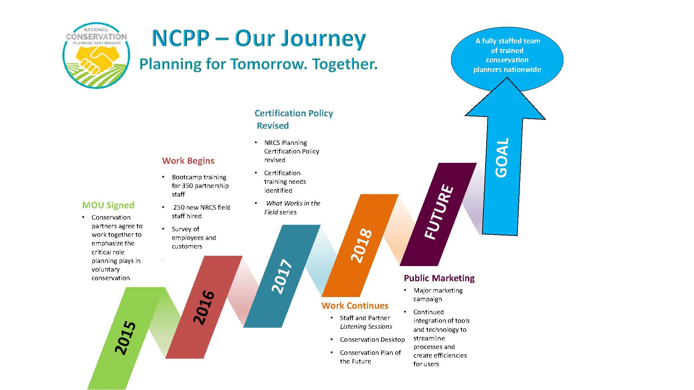
Notes:
There have been key accomplishments made which have allowed for the expansion of boots on the ground, increased technical expertise, knowledge transfer and engaged dialogues that will expand to include the feedback that we will receive today and for the remaining six sessions. Your input is key and will help to ensure that we have identified and addressed all of the known issues, needs and goals for this effort.

Slide 22

Thank You!
USDA and its partners are equal opportunity providers, employers and lenders.
Notes:
As we work to plan for tomorrow together, let us all be reminded that conservation planning is our first interaction with our customers and will help to ensure a good customer experience!

