Slide 1
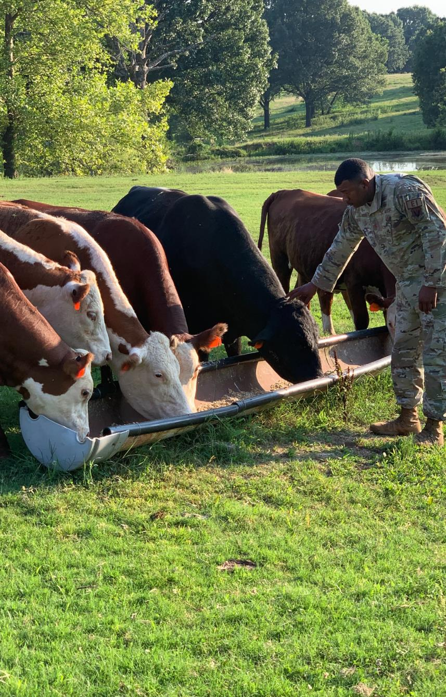
Diversity, Equity, and Inclusion in American Agriculture

Slide 2
May 15, 1862 USDA is founded. Lincoln calls it, "The People's Department."

Slide 3
1920
14% of all farms are black operated
1965
Commission on Civil Rights finds USDA discriminated against minorities in loan and conservation payments.
Historical Facts
1965, 1967, 1970,
1981, 1982, 1990, 1995, 1996, 1999
Reports detailing active discrimination, lack of response, and decline of minority producers at the hands of USDA.
1910 - 1997
Black farmers lost 90% of the land they owned. White farmers lost 2%.

Slide 4
2001 - 2008
14,000 complaints of discrimination are filed against USDA. USDA acts on 1 complaint.
2008 -
Pigford II Settlement
Historical Facts
2011 -
Keepseagle Settlement
2011 -
Hispanic & women lawsuit settlement
2020
Minority producers receive 0.26% of the CFAP funds.

Slide 5
6/26/2019

Slide 6
Discrimination in 2021
- Overt
- Systemic
- Passive

Slide 7
WHAT STEPS HAS USDA TAKEN?
- Advisory Committees
- Outreach Efforts
- Specialized Funding Pools

Slide 8
WHAT DOES THAT HAVE TO DO WITH US?
Producers do not see USDA and Districts as separate entities.

Slide 9
Goals
CARE: Conservation & Agriculture Reach Everyone
#1
Increase the number of socially disadvantaged farmers and ranchers and veterans accessing conservation technical assistance and financial assistance from both NRCS & their local conservation district.
#2
Improve the health of the soil on SDA producers operations.

Slide 10
Goals
CARE: Conservation & Agriculture Reach Everyone
#3
Increase the number of SDA and veteran producers educated about heirs property, highly fractionated land, the Uniform Partition of Heirs Property, estate planning, and 2018 Farm Bill changes that address these issues.
#4
Reduction of invasive species, specifically, the Chinese Tallow and the Eastern Red Cedar on SDA and veteran operations.

Slide 11
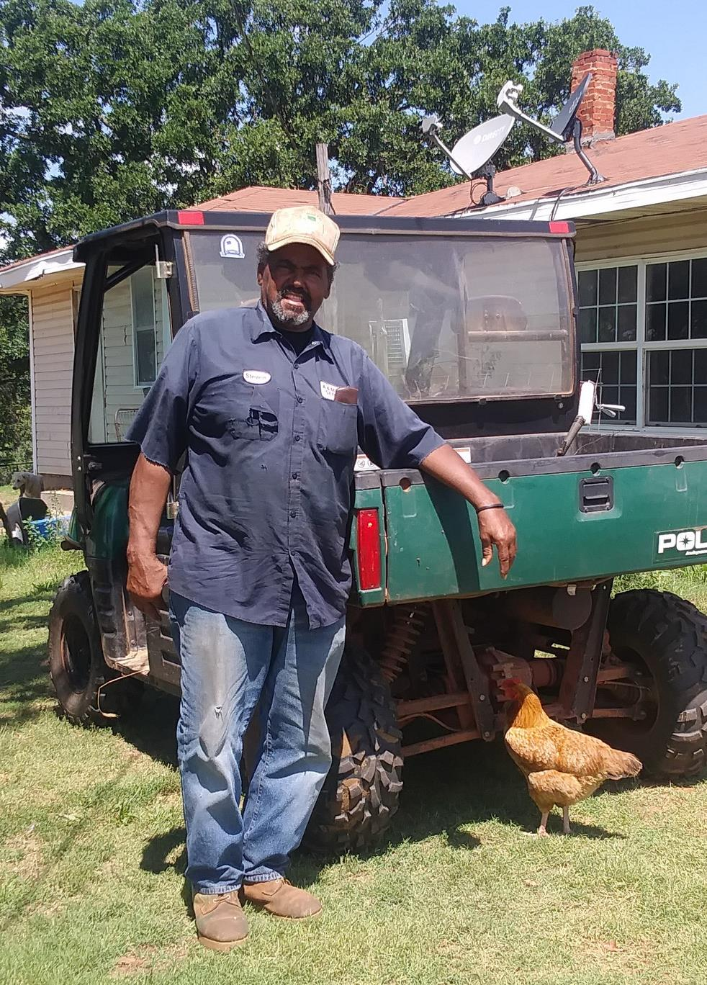
Our Partners
The project is led by the Oklahoma Association of Conservation Districts, Oklahoma Black Historical Research Project, The Texas Association of Soil and Water Conservation Districts, the Texas Agriforestry Small Farmers and Ranchers.
Our collaborators include the Oklahoma Conservation Commission, the Oklahoma Prescribed Burn Association, the Nature Conservancy, SAVE Farms, and the Muscogee Nation. The project is delivered through 16 conservation districts in OK and 4 in TX.

Slide 12
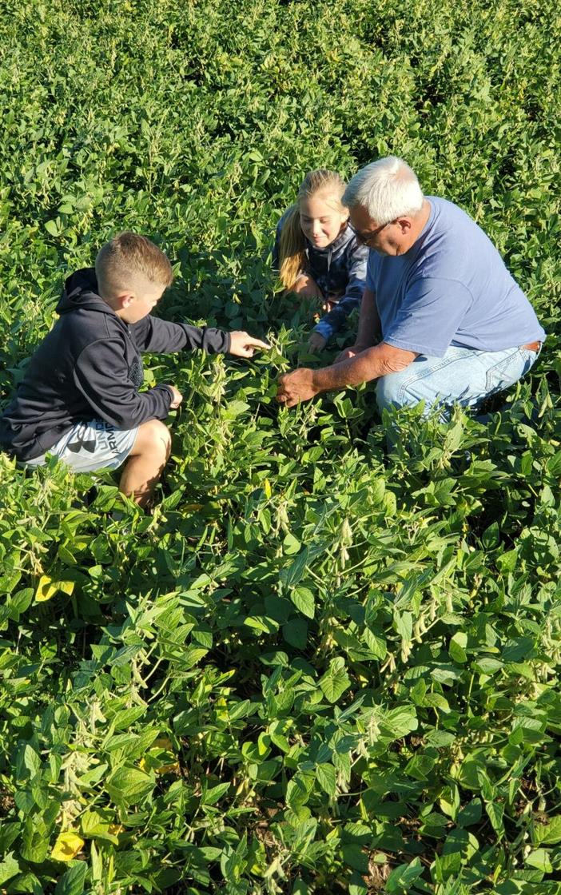
What the CARE Project Does
Works with community based organizations that are well respected within our targeted areas to build relationships and establish trust.
Identifies SDA and/or veteran champions that are willing to share their experiences - both positive and negative with us.
Conducts one on one, in-depth interviews with champions to learn about their unique experiences.
Surveys all producers that districts are in contact with to get a baseline of the number of SDA and veteran producers that we are reaching in a given year.
Establishes demonstration farms in Oklahoma and Texas on SDA and/or veteran managed land.
Educates district employees and directors about the history of SDA producers in Oklahoma.
Provides leadership opportunities to champions through SAVE Farm, TNC Leadership Class, and OACD Leadership Class.
Encourages champions to seek office at their local conservation district and on their county FSA boards.
Provides space for SDA and veteran producers to have peer networking opportunities.
Builds a bridge between communities and districts.

Slide 13
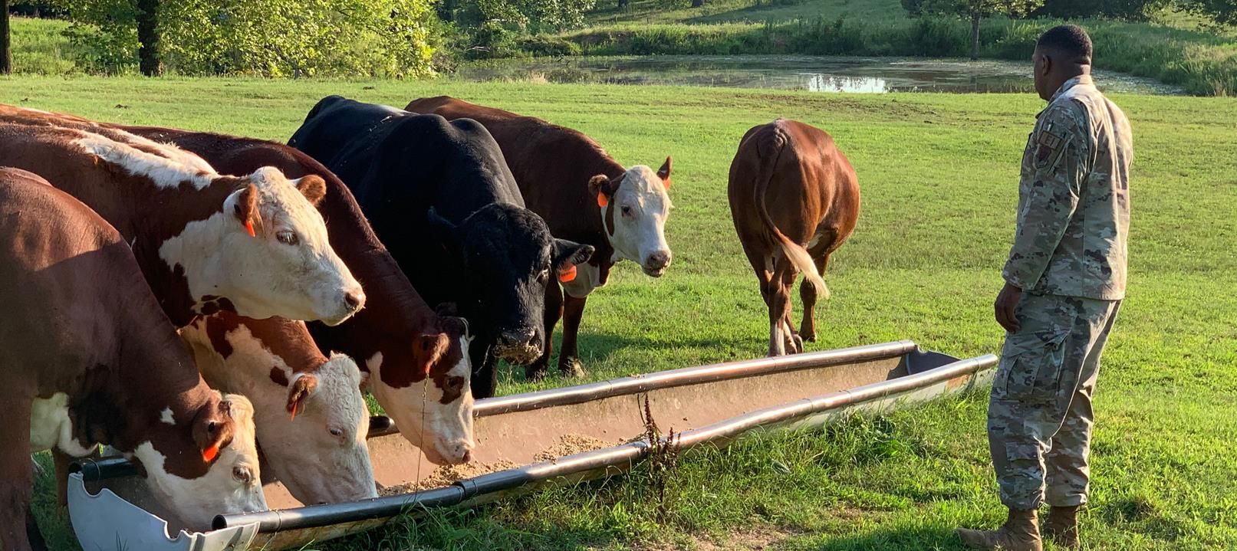
Oct. 1, 2020 - June 30, 2021
2,662 producers reached.
1,397 SDA
185 Veterans
18 Champions Identified in OK
4 Champions identified in TX
32 demonstration farms
$70/acre on the farms
2 conservation planners
The Numbers

Slide 14
Growth Opportunity
There are 246,176 minority producers in the US according to the ag census. There's an additional 288,264 female farmers in the U.S.

Slide 15
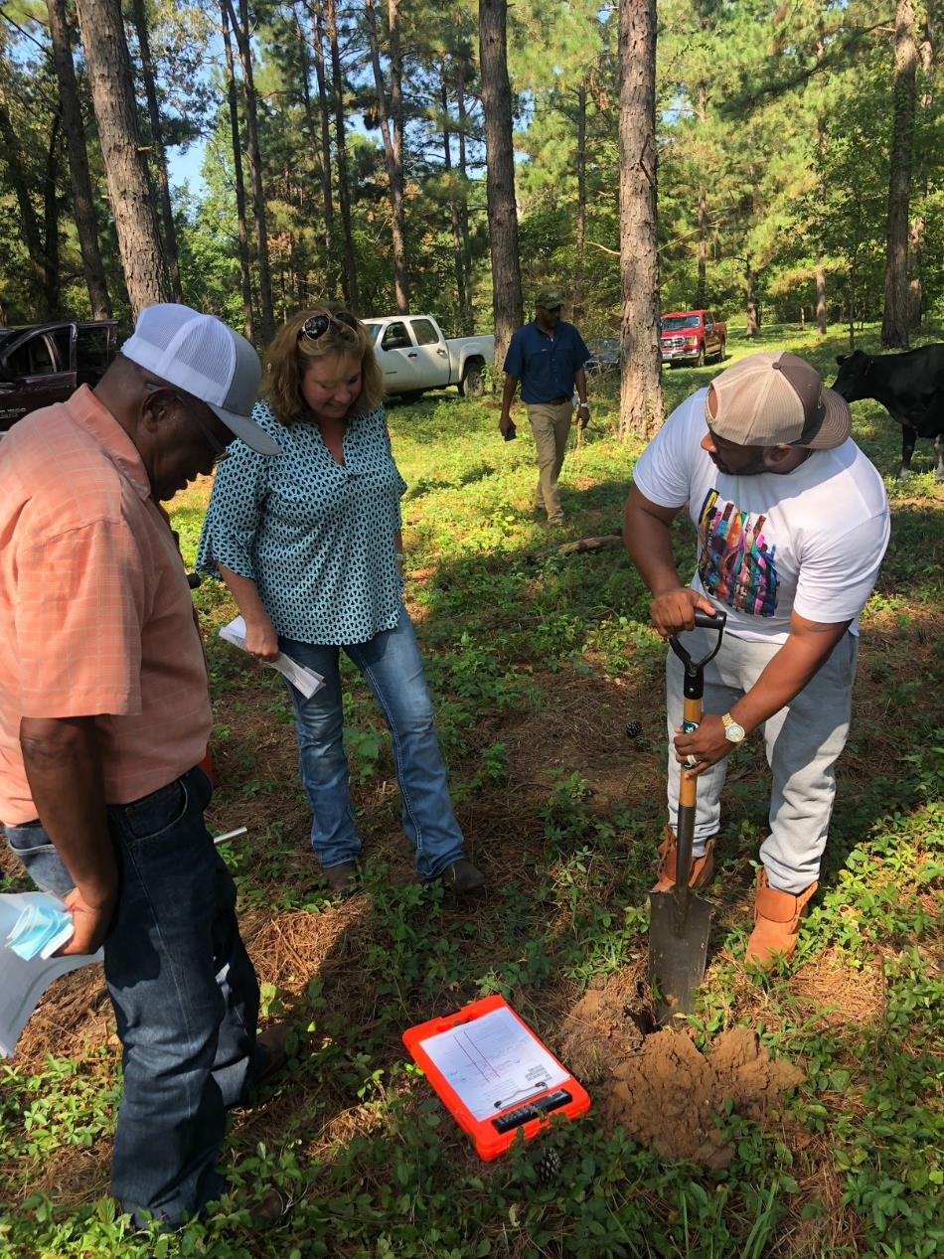
What you can do to help
- Meet with leaders of minority farming organizations in your state one on one.
- Be cognizant and proactive in inviting BIPOC farmers and experts to participate in your organization's activities.
- Educate yourself about the unique challenges and opportunities available for BIPOC producers in your state and federally.

Slide 16
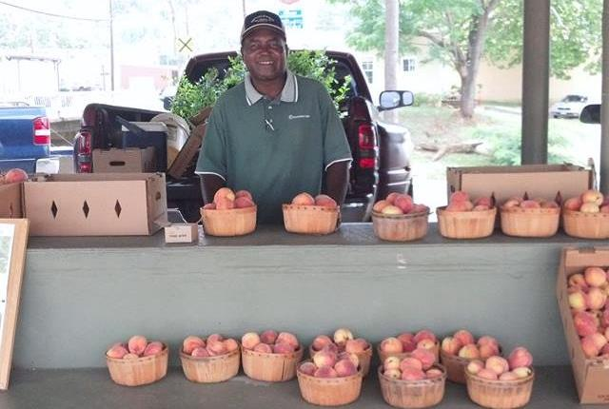
Resources
National Rural Coalition (DC based)
Federation of Southern Cooperatives (GA & AL based)
National Latino Farmers and Ranchers Trade Association (DC based)
Land Loss Prevention Project (NC based)
Indian Nations Conservation Alliance (NM based)

Slide 17
01
04
Problems we are solving or opportunity we are going after
Key Metrics. How will we know we have achieved this goal? How do we know if we are successful?
Boost sales by maximizing food delivery opportunities
Company Strategy 2 Summary
A 40% to 60% increase in sales is expected
02
Support we need to achieve this goal
05
Menu planning and courier service partnerships
Risks or Possible Blockers
as of the moment
Insurance expenses and workarounds for delays
This is our plan to make our food delivery service exclusive and top-notch.
03
How will achieving this goal have a great impact?
Free marketing, customer loyalty, greater reach

Slide 18
Improve in-store and online customer service
As a business operating for more than a decade,
it’s important for us to continuously check all our customer-facing endpoints. This season, we will start by doing an audit of our in-store and online customer service experience.

Slide 19
Summary
Problems we are solving or opportunity we are going after
Support we need to achieve this goal
How will achieving this goal have a great impact?
Key Metrics. How will we know we have achieved this goal? How do we know if we are successful?
New and creative methods for advertising and promotion
Social media, display, and outdoor advertising
Tie-ups with advertising companies
Increased brand awareness, sales, and a larger market size
An estimated 50% ROI
Food delivery exclusive offers
Boost sales by maximizing food delivery opportunities
Menu planning and courier service partnerships
Free marketing, customer loyalty, greater reach
A 40% to 60% increase in sales
is expected
Improve in-store and online customer service
Address comments on our service being outdated.
A complete audit of all customer-facing endpoints.
Fostered customer loyalty
and brand love
A 35% increase in customer retention

Slide 20
Thank you!

Slide 21
Our Team
Megan Rollins
Terrence Barkley
Christina Lightly
Marketing Director
Marketing Specialist
Creative Director

Slide 22
Free Resources
Use these free recolorable icons
and illustrations in your Canva design

